Slide 1
DOM

Slide 2

TREE DATA STRUCTURE

Slide 3
DESCRIPTION
A DATA STRUCTURE THAT CONSISTS OF NODES IN A PARENT/CHILD RELATIONSHIP.
Tree are non-linear ( many different path).

Slide 4
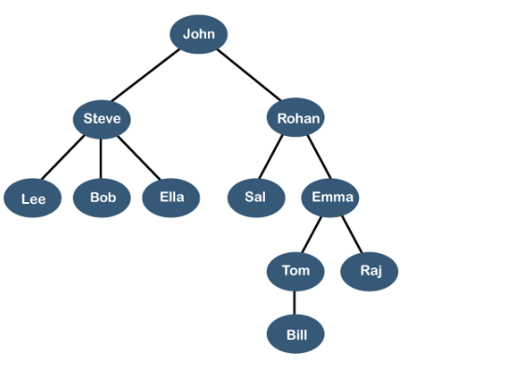
REAL TIME EXAMPLE LINKEDIN FRIENDS

Slide 5
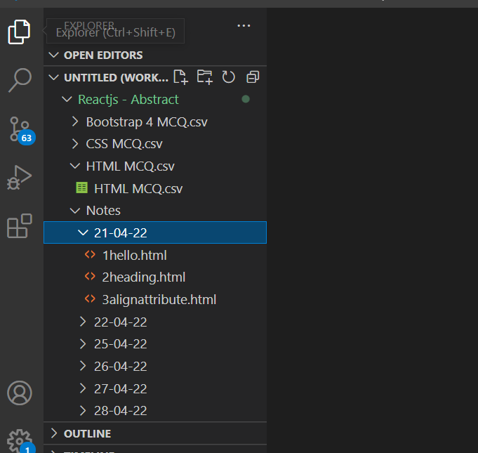
FILE SYSTEM

Slide 6
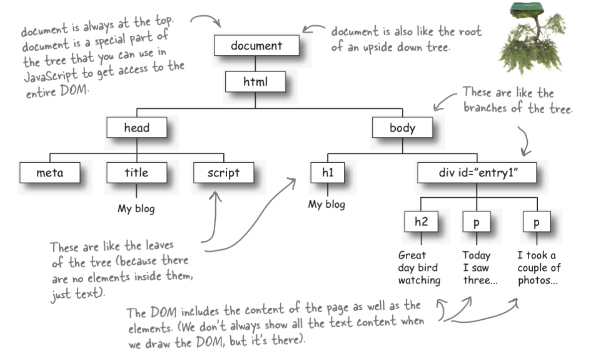
What is DOM ?
When a web page is loaded, the browser creates a Document Object Model of the page
The HTML DOM model is constructed as a tree of Objects:

Slide 7
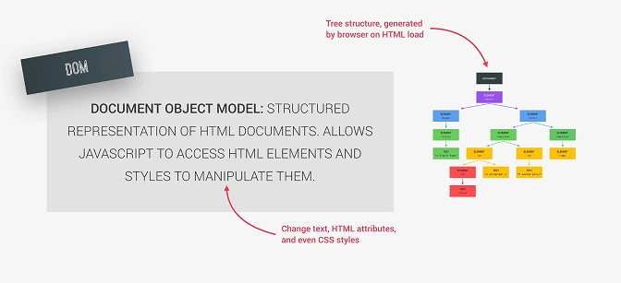

Slide 8
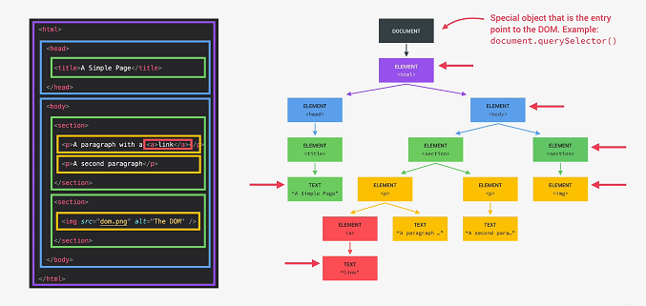

Slide 9
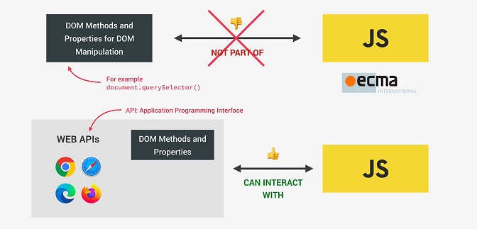

Slide 10
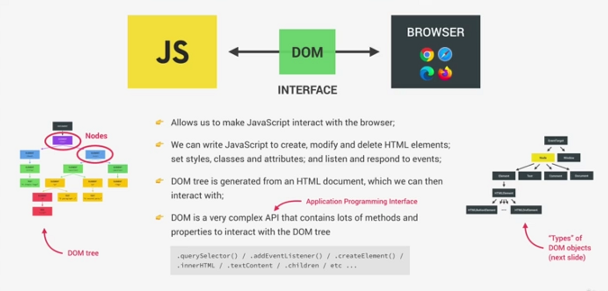

Slide 11
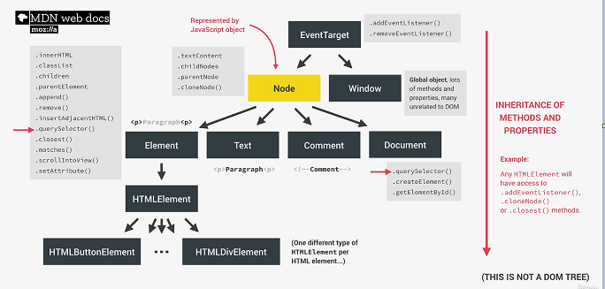

Slide 12
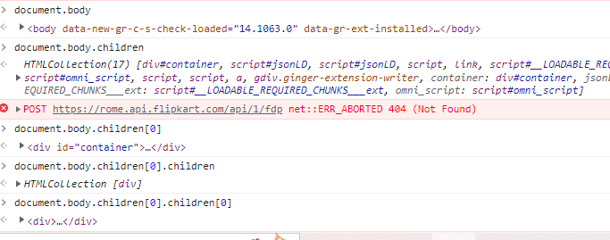
HTML DOM

Slide 13
What we can do using DOM?
Using DOM, JavaScript gets all the power it needs to create/update HTML:
JavaScript can change all the HTML elements in the page
JavaScript can change all the HTML attributes in the page
JavaScript can change all the CSS styles in the page
JavaScript can remove existing HTML elements and attributes
JavaScript can add new HTML elements and attributes
JavaScript can react to all existing HTML events in the page

Slide 14
DOM Methods
HTML DOM methods are actions you can perform (on HTML Elements)
HTML DOM properties are values (of HTML Elements) that you can set or change
<html>
<body>
<p id="demo"></p>
<script>
document.getElementById("demo").innerHTML = "Hello World!";
</script>
</body>
</html>
innerHTML is a property
getElementById is a method

Slide 15
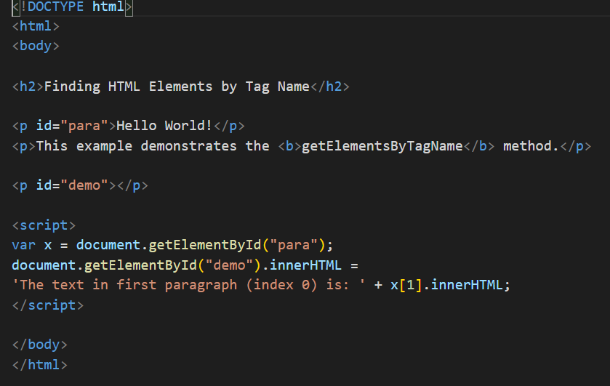
getElementById

Slide 16
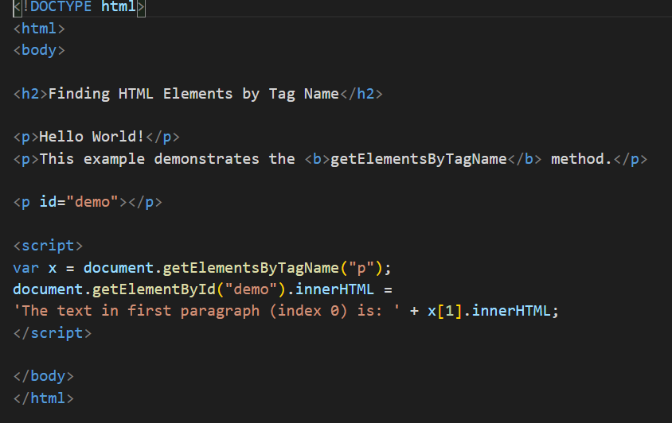
getElementsByTagName

Slide 17
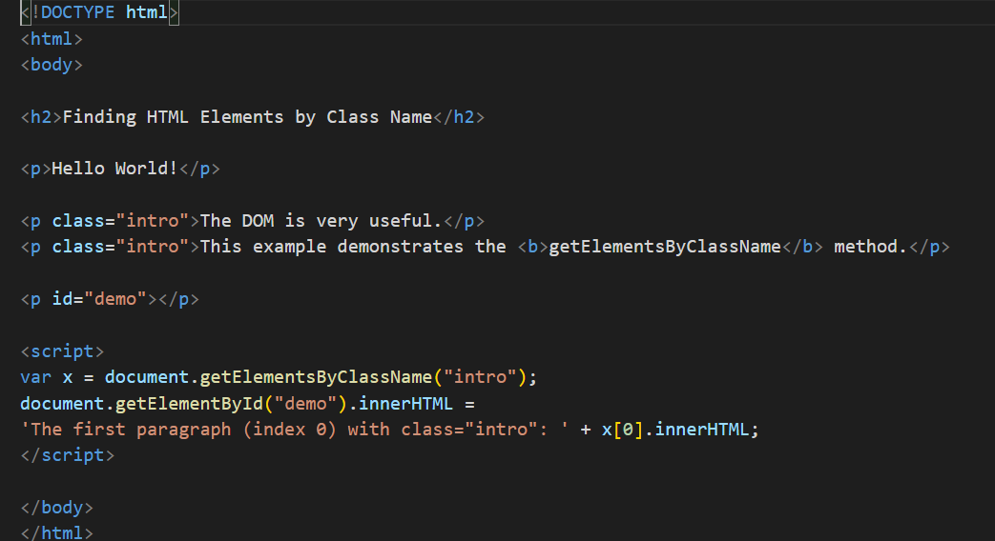
getElementsByClassName

Slide 18
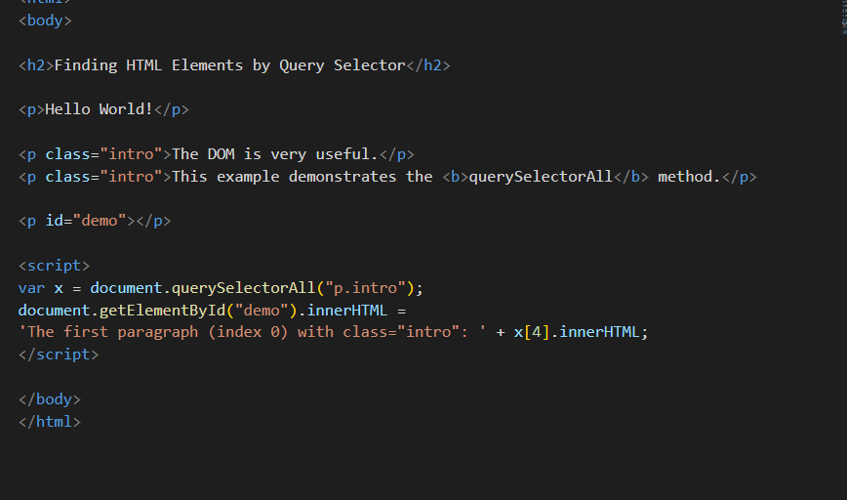
CSS QuerySelector

Slide 19
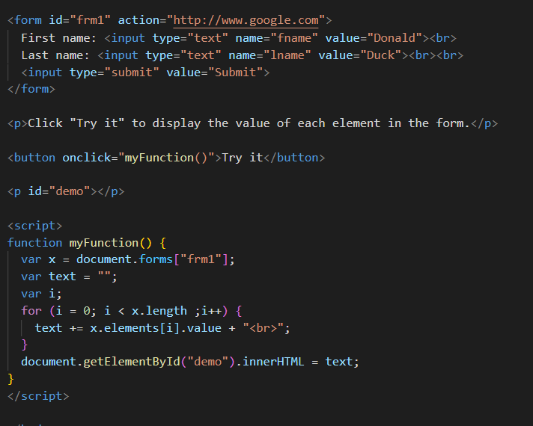
Form Object Collection

Slide 20
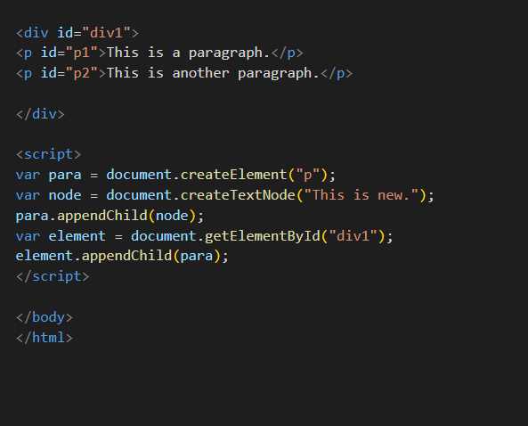
ADD DOM

Slide 21
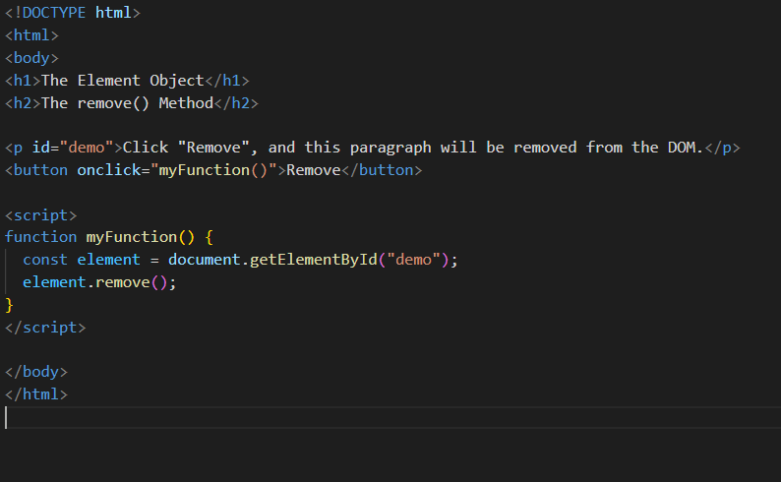
Remove DOM

Slide 22
DOM Methods
getElementById - To change/modify the content of an HTML element
<script>
document.getElementById("p1").innerHTML = "New text!";
</script>
Changing HTML Content
<script>
document.getElementById("myImage").src = "landscape.jpg";
</script>
Changing the Value of an Attribute
<script>
document.getElementById("myP").style.backgroundColor = "red";
</script>
Changing Style property
<script>
document.getElementById("myP").classList.add(“box”); </script>

Slide 23
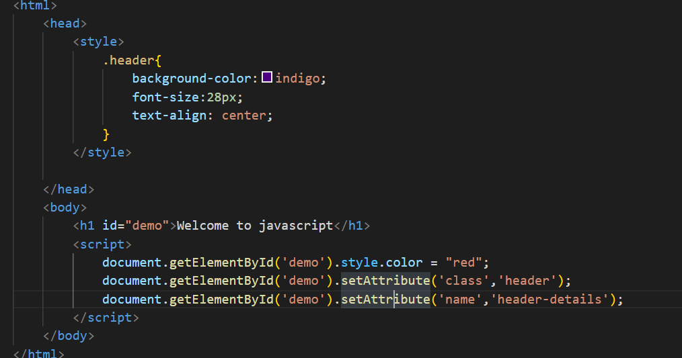
Style and class

Slide 24
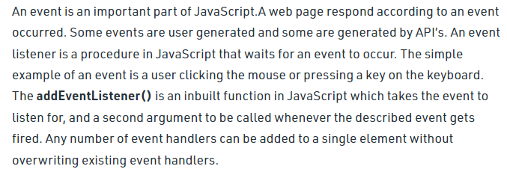
Events

Slide 25
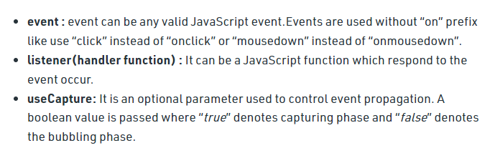
Events

Slide 26
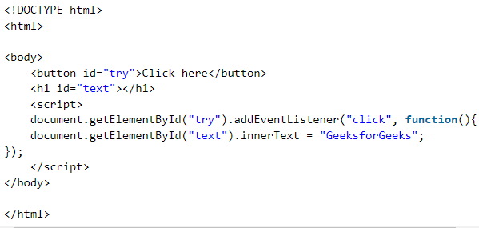
Events

Slide 27
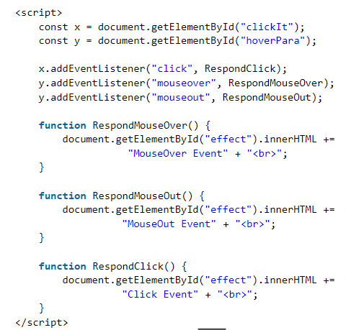
Events

Slide 28
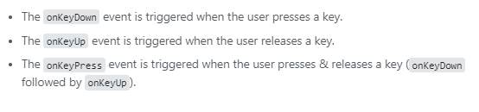
Events

Slide 29
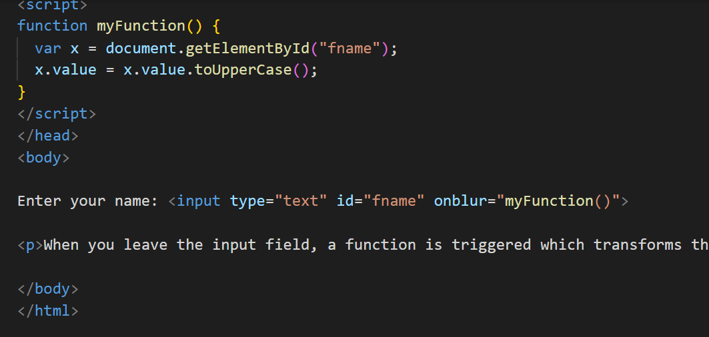
onBlur

Slide 30
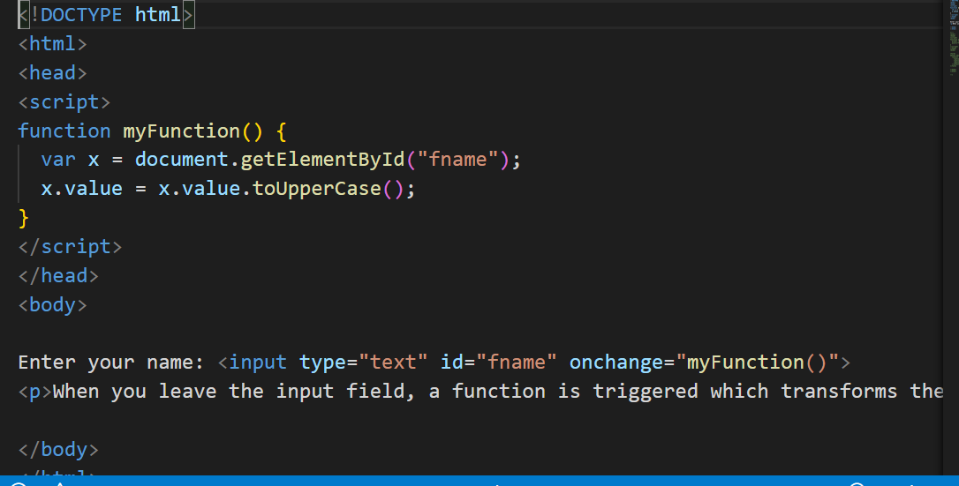
onChange

Slide 31
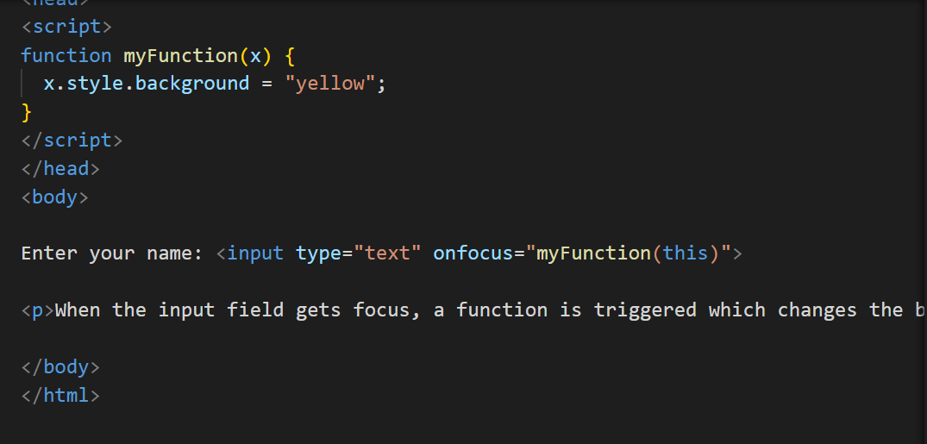
onFocus

Slide 32
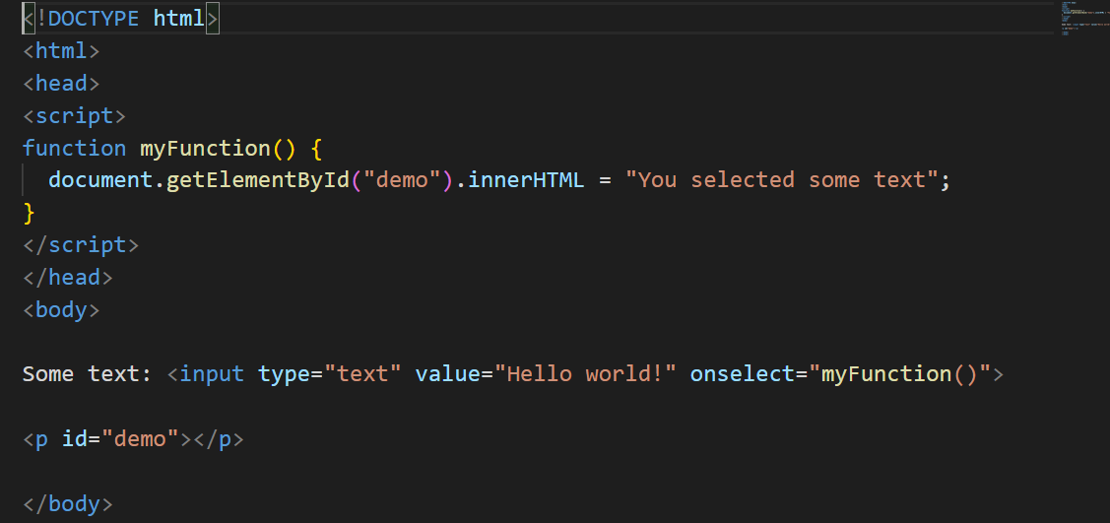
onSelect

Slide 33
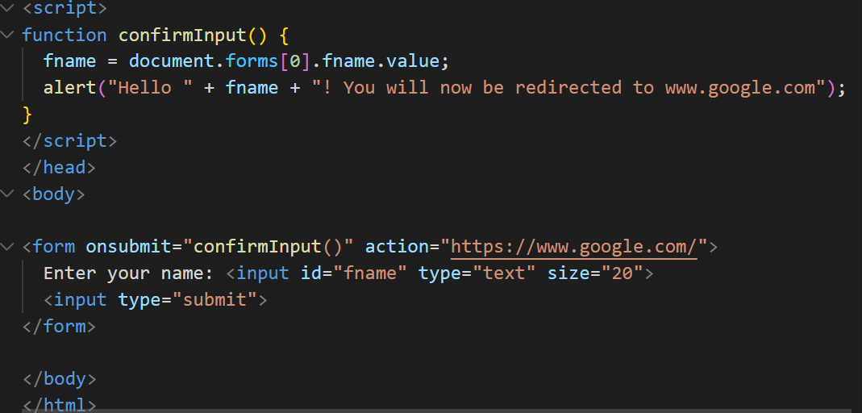
onSubmit

Slide 34
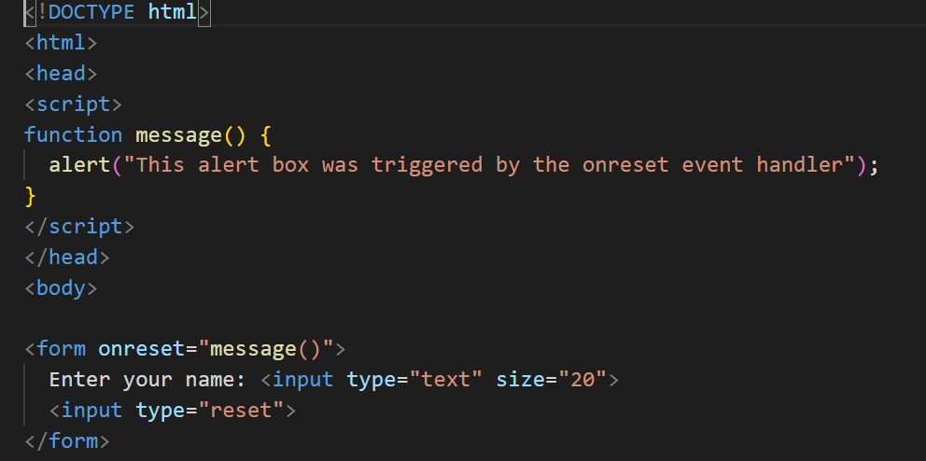
onReset

Slide 35
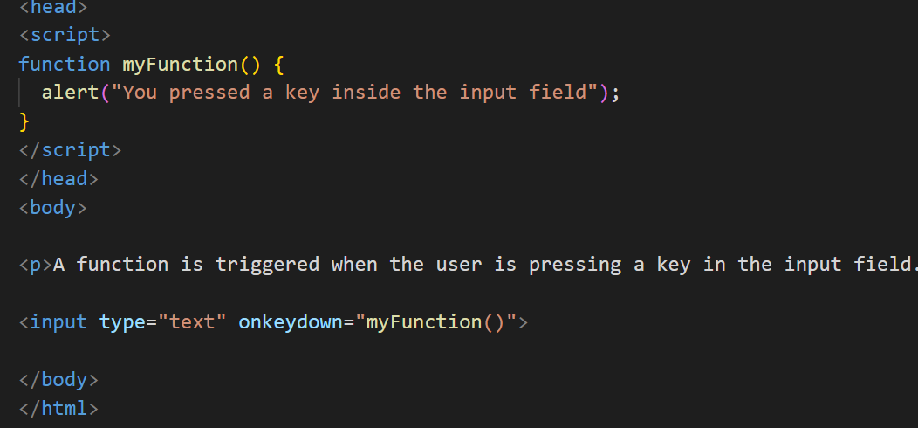
onKeyDown

Slide 36
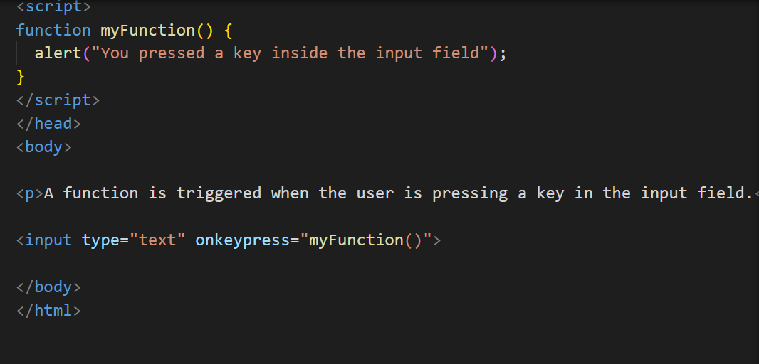
onKeyPress

Slide 37
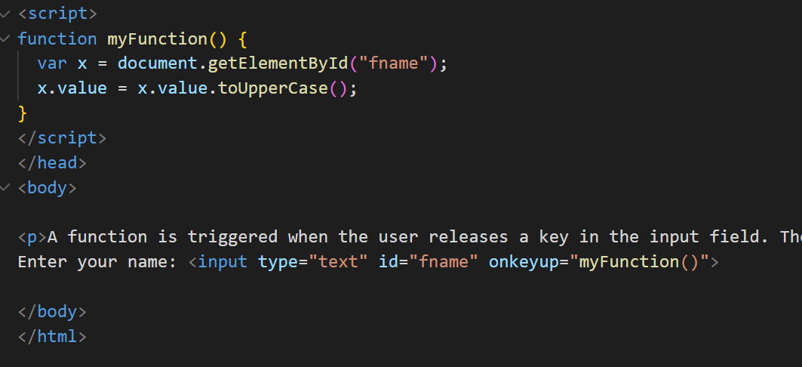
onKeyUp

Slide 38
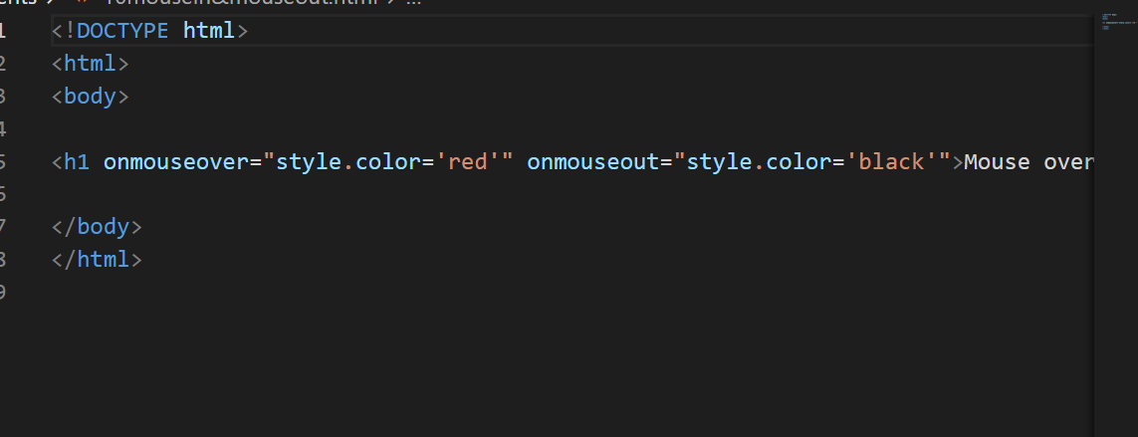
onMouseOver and onMouseOut

Slide 39
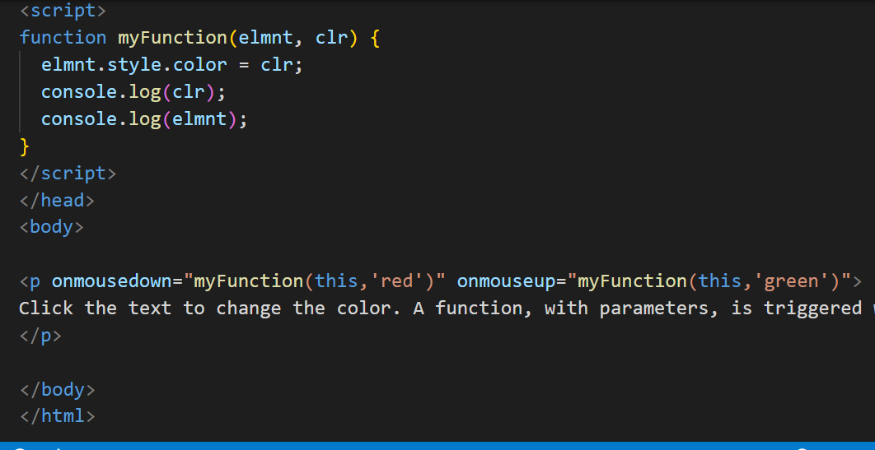
onMouseDown and onMouseUp

Slide 40
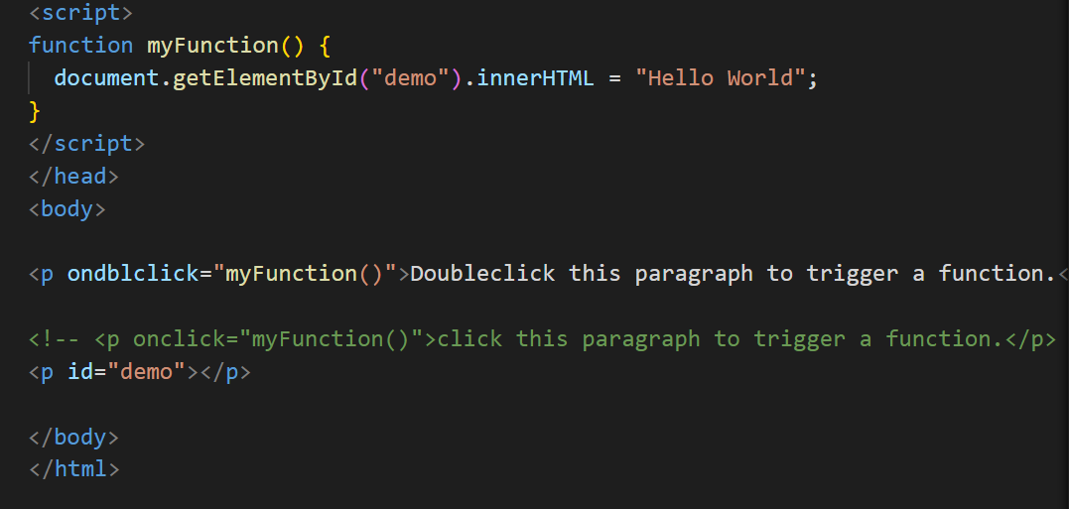
onDoubleClick

Slide 41
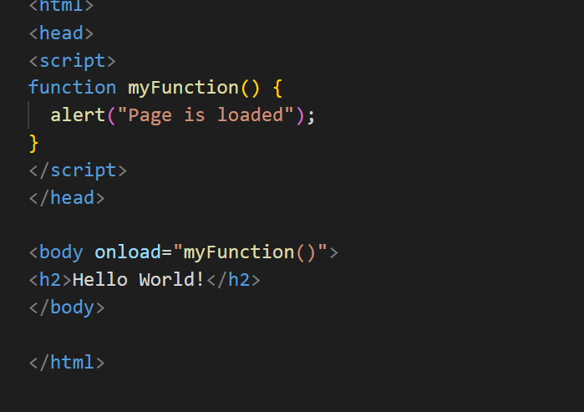
onLoad

Slide 42
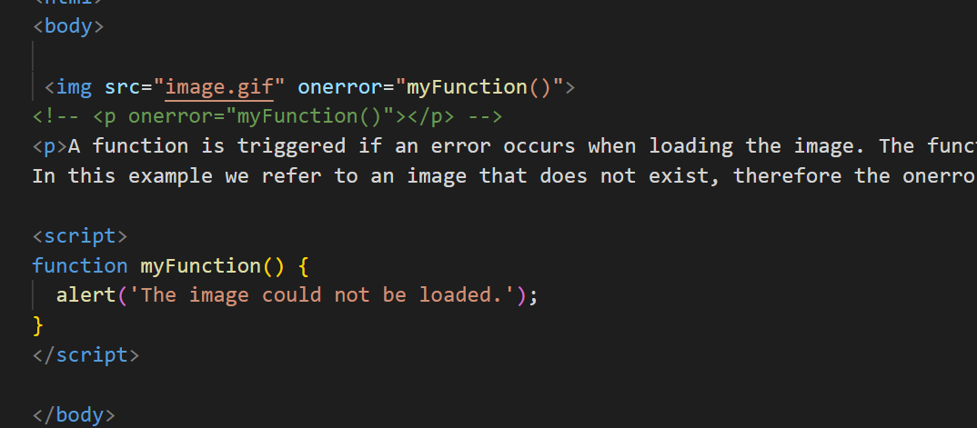
onError

Slide 43
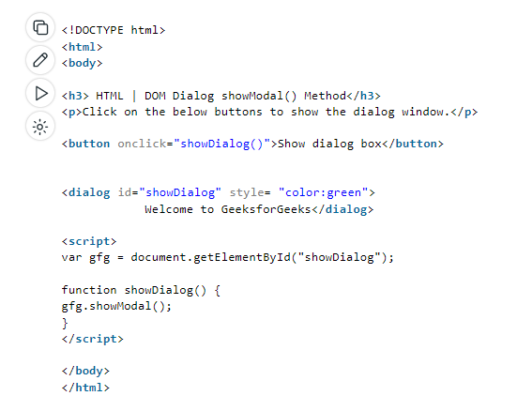
DOM Modal - showModal()

Slide 44
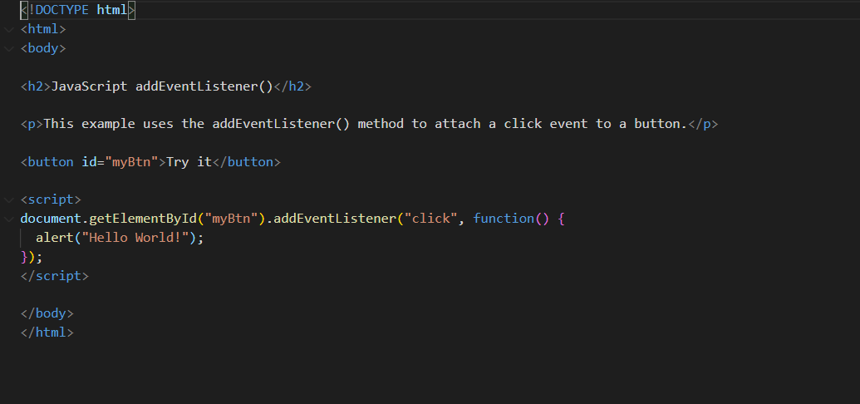
Event Listener

Slide 45
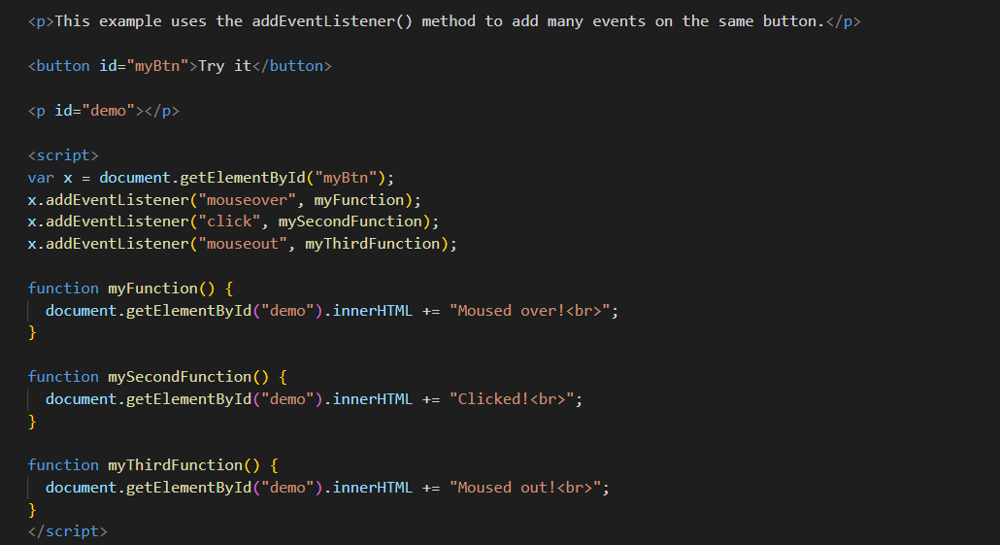
Event Listener

Slide 46
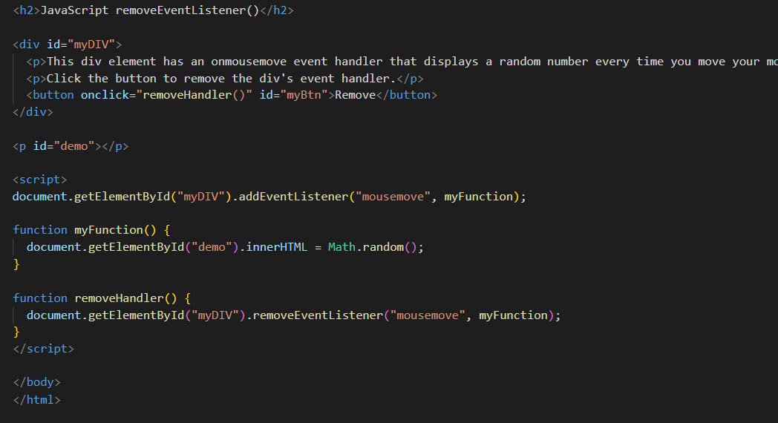
Remove Event Listener

Slide 47
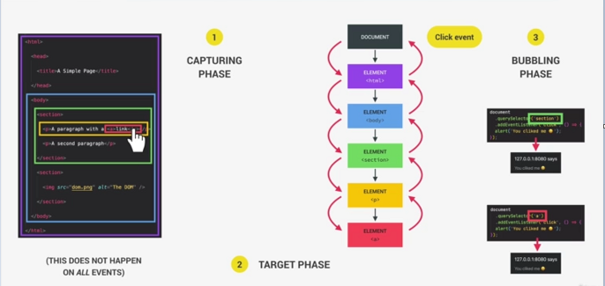
Bubbling and Capturing

Slide 48
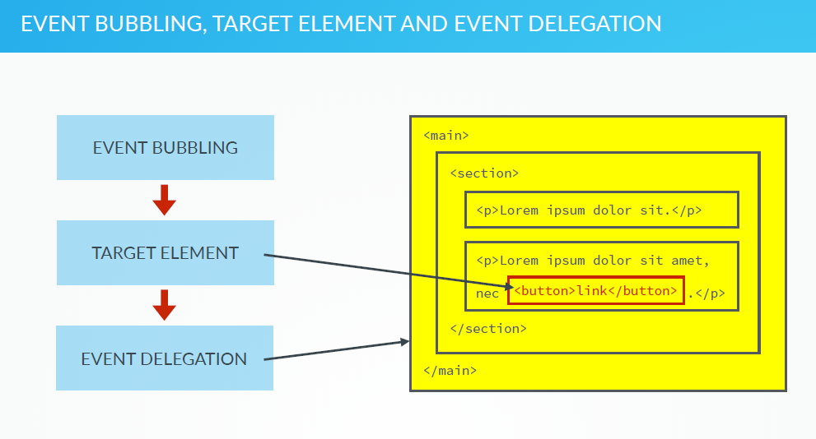

Slide 49
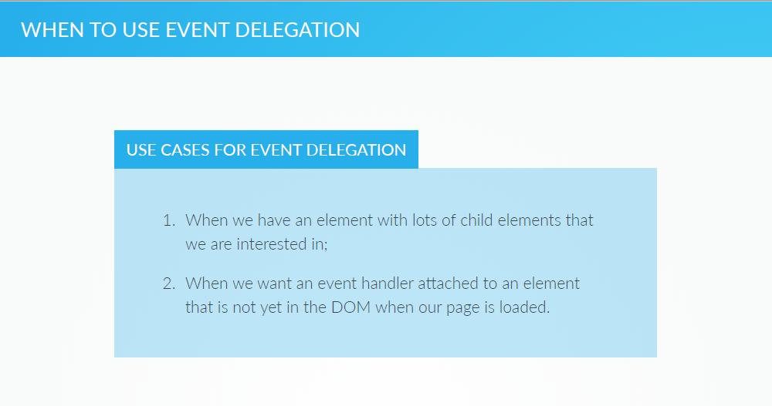

Slide 50
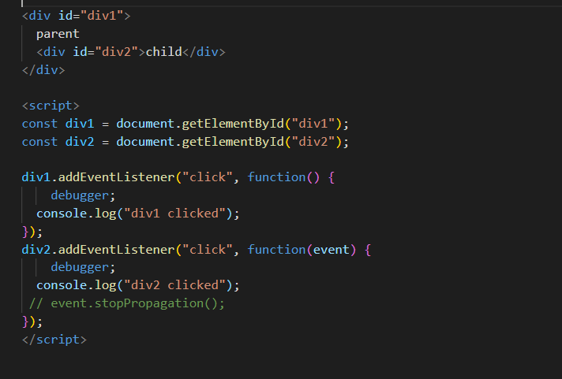
Event Bubbling Example

